Slide 1
Other Pipeline Details

Slide 2
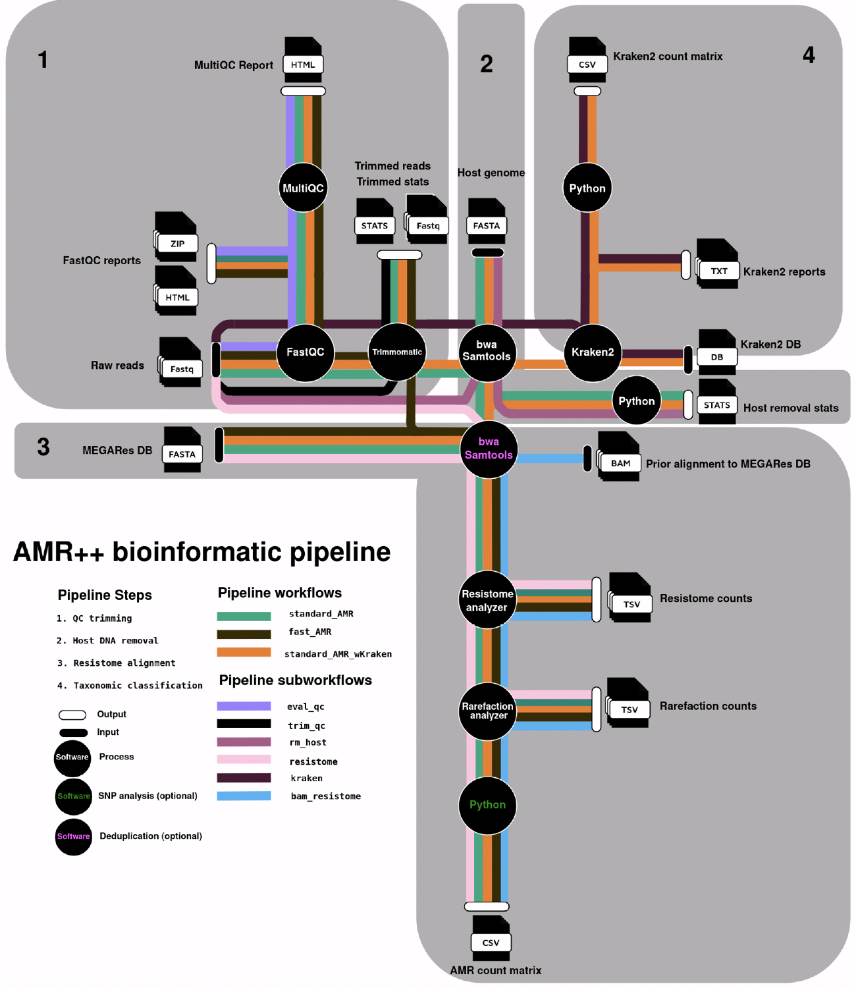
Notes:
- So how do we actually correct for Illumina systemic bias?
- We do this with read trimming, which is done as the first step in the AMR++ pipeline.

Slide 3
Rarefaction in the AMR++ pipeline
Motivation: We needed a method to help us understand:
How much sequence data should we request? (before sequencing)
How much of a sample’s AMR diversity are we detecting? (after sequencing)

Slide 4
AMR++: RarefactionAnalyzer
Approach: Randomly subsample range of sequence data (X% to Y%), at Z intervals, with A repetitions:
Example: subsample sequence data from 5% to 100% of the total reads, in 5% increments, and take the average of 10 subsamples at each increment
Run each subsampled dataset through pipeline
For each increment, calculate number of unique:
– Genes
– Groups
– Mechanisms
– Classes
Output the results in a file for each level (user can create plot)

Slide 5
An example from AMR++ pipeline…
Enriched Samples
Nonenriched Samples

Slide 6
What about all of this SNP stuff?

Slide 7
The story of some AMR genes…
Some AMR genes are only “AMR” because of a (set of) SNPs
Using the gyrA example (fluoroquinolone resistance):
The resistant mutant contains the amino acid Alanine at position 67, instead of the wild type Serine (A67S)
Resistant reference (SAR) = TCT-GCG-CGT
Wild type variant (SSR) = TCT-TCG-CGT
Resistant variant (SAR) = TCT-GCA-CGT
With alignment (and many other methods), both the wild type variant and the resistant variant could be mapped to the AMR reference gene

Slide 8
How extensive is this issue?
589 out of 8,733 total accessions in MEGARes (6.7%)
However, this impact is not evenly distributed across classes
For example, >40% of fluoroquinolone ARGs fall into this category

Slide 9
Solving this problem is not simple…

Slide 10
Current options:
Ignore the whole issue (not recommended, but often done)
Drop these “SNP genes” from your analysis completely, and state clearly that you aren’t considering these genes (MEGaRES allows you to do this more easily than other databases…”RequiresSNPConfirmation” flag)
Attempt to validate the genes (CARD RGI and/or AMR++ v3)

Slide 11
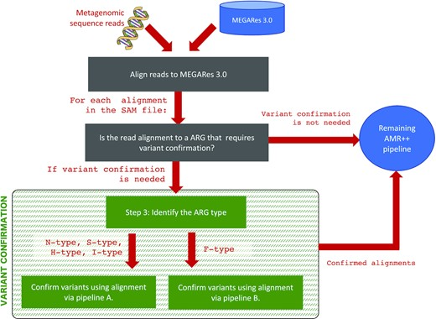
AMR++ v3

Slide 12
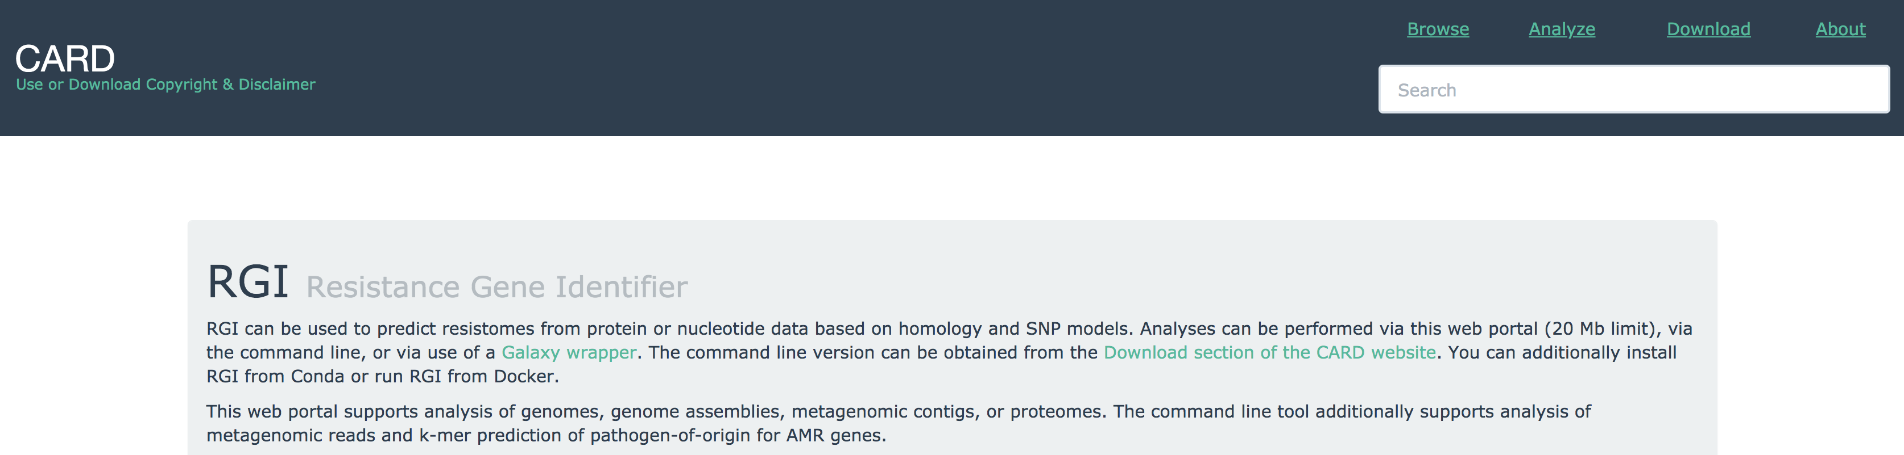
One option is to use CARD’s RGI
To Note:
Requires multiple software tools: Prodigal, DIAMOND
Requires either command line OR Docker/Galaxy/Conda (>20Mb)
Not all “SNP genes” are currently supported
Must think very hard about interpretation and robustness of results

Slide 13
Questions???

